Slide 1
Udacity
Marketing Analytics
Nanodegree Program
Project: Craft a Report

Slide 2
Objective Results
The Objectives are listed below, your job is to asses the data and report on the performance against the objectives:
Increase total sales by 30% on Black Friday 2018 vs. Black Friday 2017. Decrease total ad spend by 30% from Black Friday 2017 to Black Friday 2018.

Slide 3
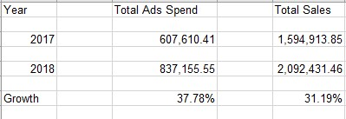
Increase total sales by 30% on Black Friday 2018 vs. Black Friday 2017.
From the above chart we see that the total sales was increased by 31.19%.

Slide 4
Hence the goal was met.
Decrease total ad spend by 30% from Black Friday 2017 to Black Friday 2018. Ad spend was increased by 37.78% from the previous year. Hence the goal was not met.

Slide 5
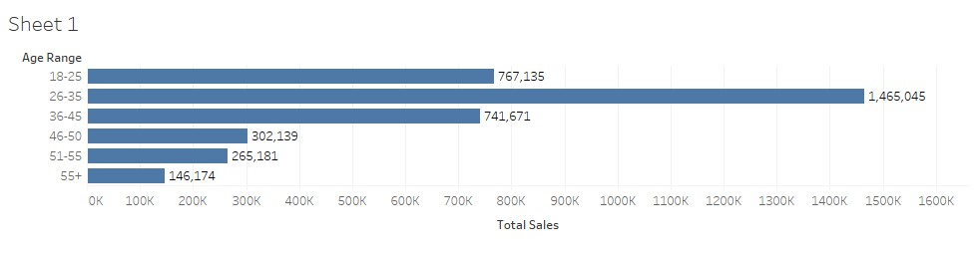
Evaluate the Audience
Demonstrate sales amount by age-range.

Slide 6
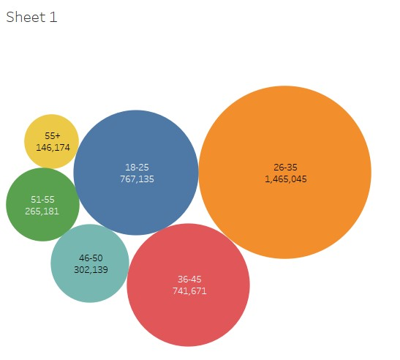
The Highest sales group was from age group 26-35. The lowest sale was from the age group 55+. The above two diagrams clearly helps us to understand sales according to age groups.

Slide 7
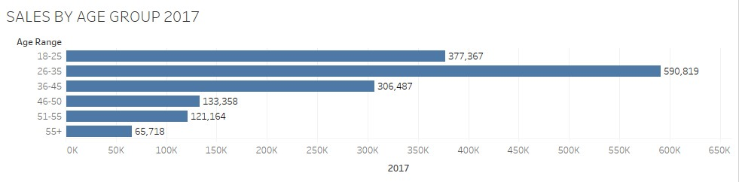
Evaluate the Audience
Which Age-Range generated the most sales?
For the year 2017-
For 2017, 26-35 generated the most sales followed by 18-25,then 36-45 then 46-50 then 51-55 and finally 55+

Slide 8
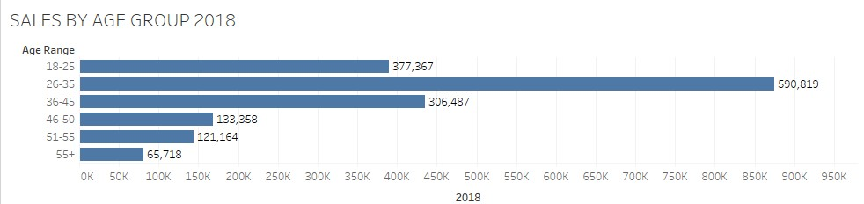
For 2018
For 2018 26-35 had the most sales, followed by 36-45 and then 18-25, then 46-50 ,then 51-55 and finally 55+.

Slide 9
For 2017and 2018 combined-
For the combined years 26-35 had the most sales, followed by 18-25,then 36-45 then 46-50 then 51-55 and finally 55+.

Slide 10
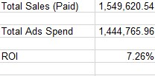
Evaluate the Marketing
Was the ROI on our Paid Channel positive or negative? What was it? Which age-range had the best CPA?
The ROI on our paid channel was positive. The ROI was found out to be positive at 7.26%. The ROI was calculated with the formula (A2-B2)/B2.

Slide 11
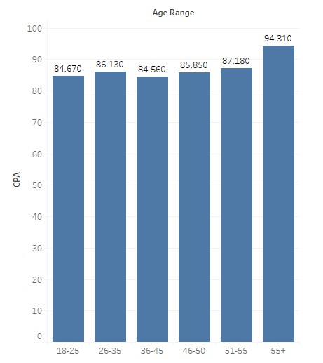
The Age range 36-45 has the best
CPA. The lowest value is usually the
Best CPA. Then the second highest
CPA is of age 18-25.

Slide 12
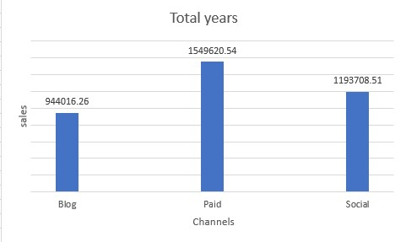
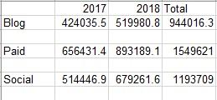
Evaluate the Marketing
Demonstrate total sales by channel
For the total years combined sales
Here we see the paid channel had the
Most sales followed social and then
Blog.

Slide 13
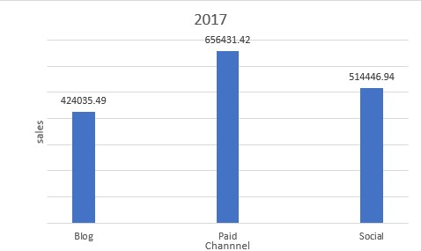
FOR 2017
Same way in 2017
Paid channel had
The most sales.

Slide 14
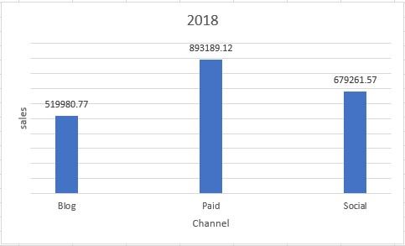
For 2018
For 2018 Paid channel also had
The most sales, followed by Social
And blog.

Slide 15

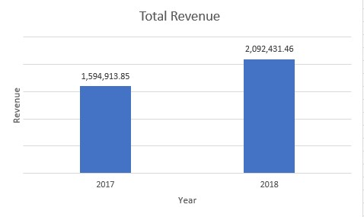
Evaluate the Sales
How much revenue did we generate in 2017? In 2018?
In 2018 there was the highest
Amount of total revenue. This was
Followed by year 2017.

Slide 16

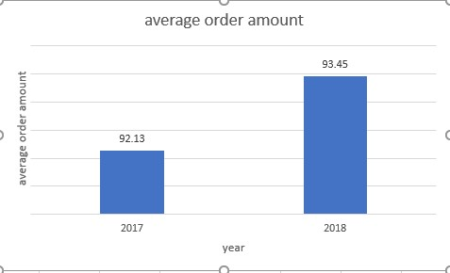
Evaluate the Sales
What was our average order amount in 2017 vs 2018?
The average order amount for 2017 was
Calculated to be 92.13 and for 2018 it
Was 93.45. So 2018 has the highest
Average order amount.

Slide 17
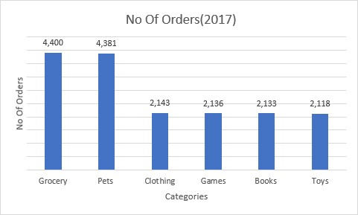
Evaluate the Product Categories
Which product category was most popular in 2017 & 2018?
For 2017-
For year 2017 Grocery had the highest no of orders. Followed by Pets and then clothing and then games, and then books and toys

Slide 18
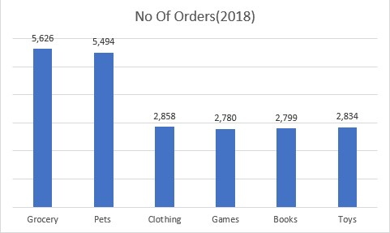
For 2018
For 2018 Grocery also had the maximum no of orders, followed by pets and then Clothing, Games , books and toys.

Slide 19
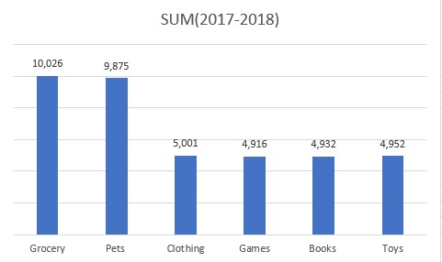
For 2017 and 2018 combined
For both the years combined no of orders this followed the same trend. The maximum no of orders was from grocery, and then Pets followed by Clothing, games, books and toys.

Slide 20
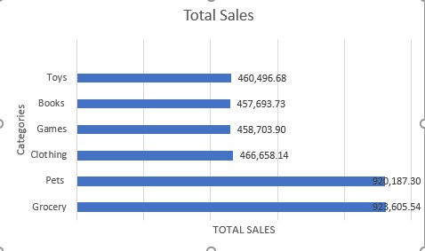
Evaluate the Product Categories
Demonstrate sales by product category

Slide 21
The total sales was maximum by grocery. The next total sale was then by pets, followed by clothing, games, books, toys. The maximum sale of grocery amounted as 923,605.54.

Slide 22
Everything Else
I used google to find out few ways to calculate. I used Excel and Tableau for diagrams, calculation ,etc.

